Slide 1


Better Applications,
Faster
Nik Molnar  nikmd23  nikmd23
Notes:
I’m Nik Molnar, I’m a web developer from Austin Texas. I work at Microsoft where I an focused on JavaScript diagnostic tooling.
I thank you for taking the time to be here today – it’s always a pleasure when I get to visit your country.
But I have to admin, I have some trouble eating here because you guys don’t seem to call anything the right name.

Slide 2
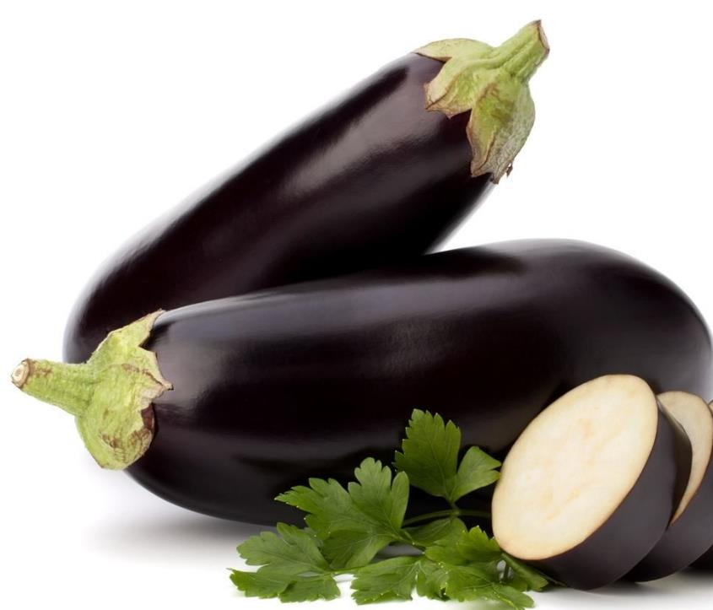
US vs UK Foods
|
01
Eggplant
Aubergine
Notes:
For example, you have aubergine.
But I eat eggplant

Slide 3

US vs UK Foods
|
02
Dessert
Pudding
Notes:
You have delicious after dinner treats that you call pudding, but of course for me that’s dessert.

Slide 4
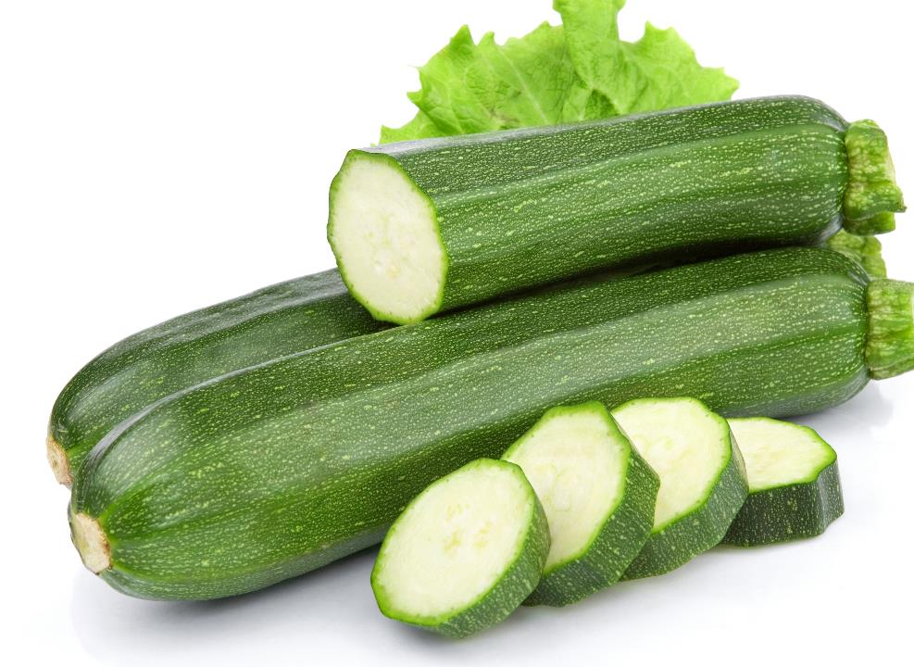
US vs UK Foods
|
03
Zucchini
Courgette
Notes:
There’s the green veggies my mom used to make me eat courgetti, which is actually zucchini

Slide 5
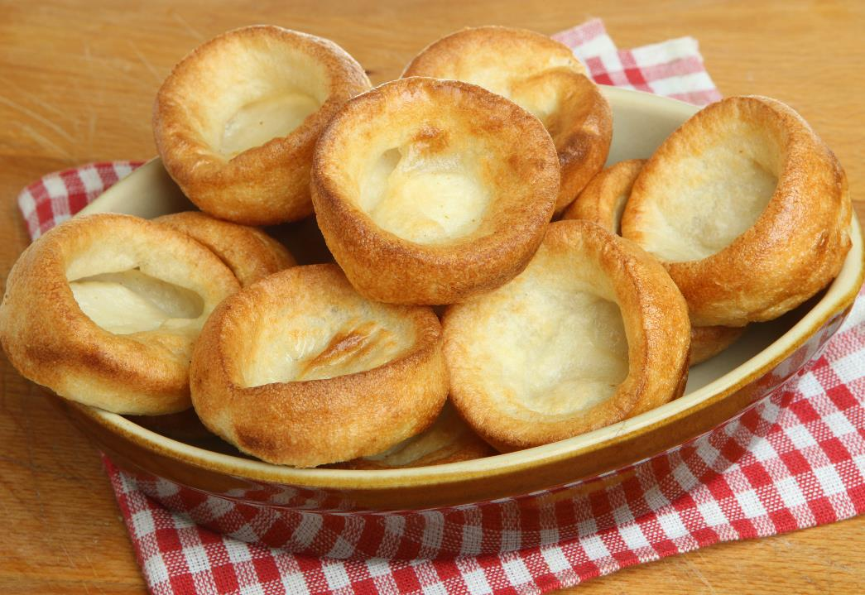
US vs UK Foods
|
04
Bread
Pudding
Notes:
You have MORE pudding, which is bread

Slide 6
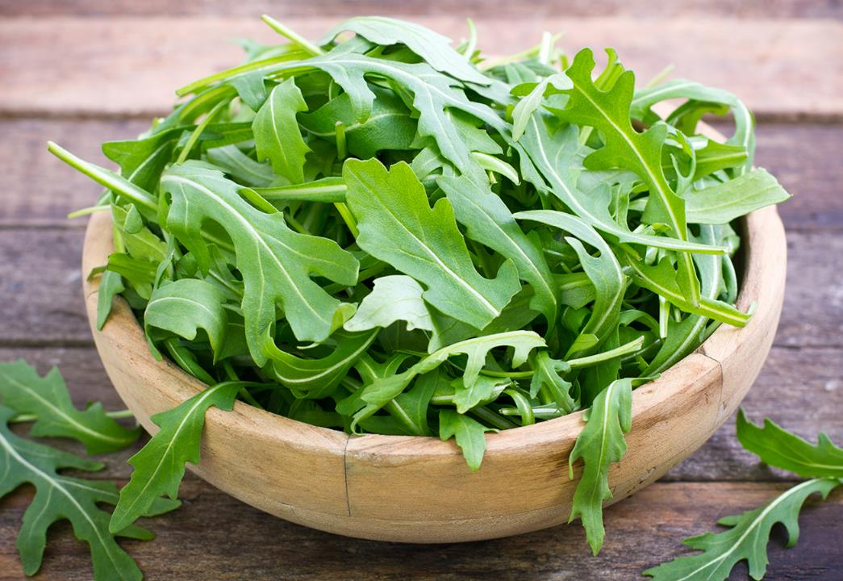
US vs UK Foods
|
05
Arugula
Rocket
Notes:
You eat rocket – and I eat arugula.
And the winner of the most overloaded term in Britisheese. Once again you have more pudding.

Slide 7
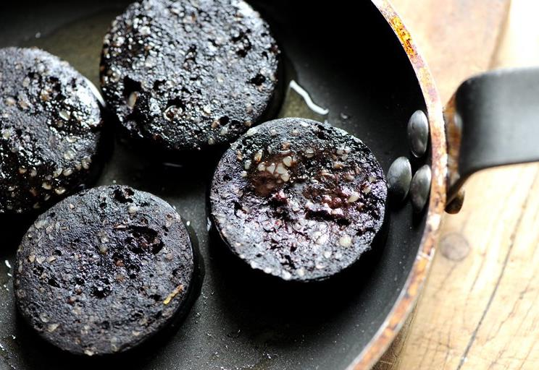
US vs UK Foods
|
06
Sausage
Pudding
Notes:
Which I call sausage.

Slide 8
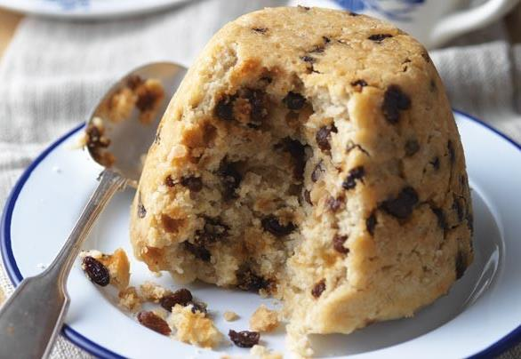
US vs UK Foods
|
Censored
07
Wat?!??
Spotted Dick
Notes:
You have a few other dishes here, but I’ve been told this is a PG show so I won’t go there. I mean, honestly, I don’t think could actually order one of these in front of my mother.
But anyways, I could talk about food all day. Let’s jump into the real reason we are here:

Slide 9
Better Applications,
Faster
Nik Molnar  nikmd23  nikmd23
Notes:
And that’s to take a look at how we can write better applications, faster.
I’ve been doing web and JavaScript development since before it was clear JavaScript was going to win and I’ve don’t it in a lot of contexts – about 20 years.
I’ve done it as a consultant for major banks and retailers in NYC, as a government contractor building security defense mechanisms, in small startups and now for one of the largest companies in the world at Microsoft.
And one lesson I’ve been taught time and time again, is that everything we do as software developers is for our users. In fact, I like to borrow a trick from Disney World, where they don’t call the people that come to the parks customers, they call them guests. Thinking of them as guests really changes the way that you prepare for them and treat them.

Slide 10
Hierarchy of Needs
Pleasurable.
Desired by users.
“Performant”.
Gets out of the way.
Useable.
Easy to learn & remember.
Reliable.
Works every time.
Functional.
Solves a problem.
Notes:
And our guests, or users, have certain needs.
Abraham Maslow’s 1943 paper "A Theory of Human Motivation" laid out the now ubiquitous Maslow’s hierarchy of needs, a psychological theory covering and prioritizing the fundamental basics that humans need to grown, thrive and flourish.
Arron Walter, the director of UX at mail chimp in Philadelphia has proposed a similar hierarchy of needs for users of software.
First software has to be functional.
Next it needs to be reliable.
From there usability becomes a concern
And I’ve actually broken out a subset of usability I call performant.
Finally, once we have our bases covered, we can begin to deliver software that it pleasurable. That is something people desire to use.
So, what I’d like to do with the rest of our time is show some of our thinking and early experiments for how Microsoft, along with the OpenFin and the rest of the JS community can work together to help you scale this mountain.

Slide 11

Functional.

Notes:
So first we’ll talk about how to make our apps functional, more quickly.
To do that let me show you a simple little ecommerce app I’ve made with node and OpenFin.

Slide 12

Reliable.
Notes:
Next let’s talk about reliability.
I think of reliability in two different veins: the first is the inevitable problem of when you have downtime or a problem in production. You want to fix those issues as fast as possible, and how fast those issues are fixed is typically tracked with a metric called mean time to recovery.

Slide 13
RisingStack Survey
How do you debug your applications?
Notes:
So as we looked at how JS developers like to fix problems, we saw an overwhelming preference for logging. I still believe that debuggers are important, and we have a great one in VS Code, but we wanted to make sure developers could use their natural workflow to reduce MTTR.
So what we’ve done is made it easy to inject a log statement into an app running in production, without requiring you to stop or redeploy your app. This is great for gathering just a bit more info
Apparently one thing that’s not reliable here is the internet, so I’ve had to prerecord this demo.

Slide 14
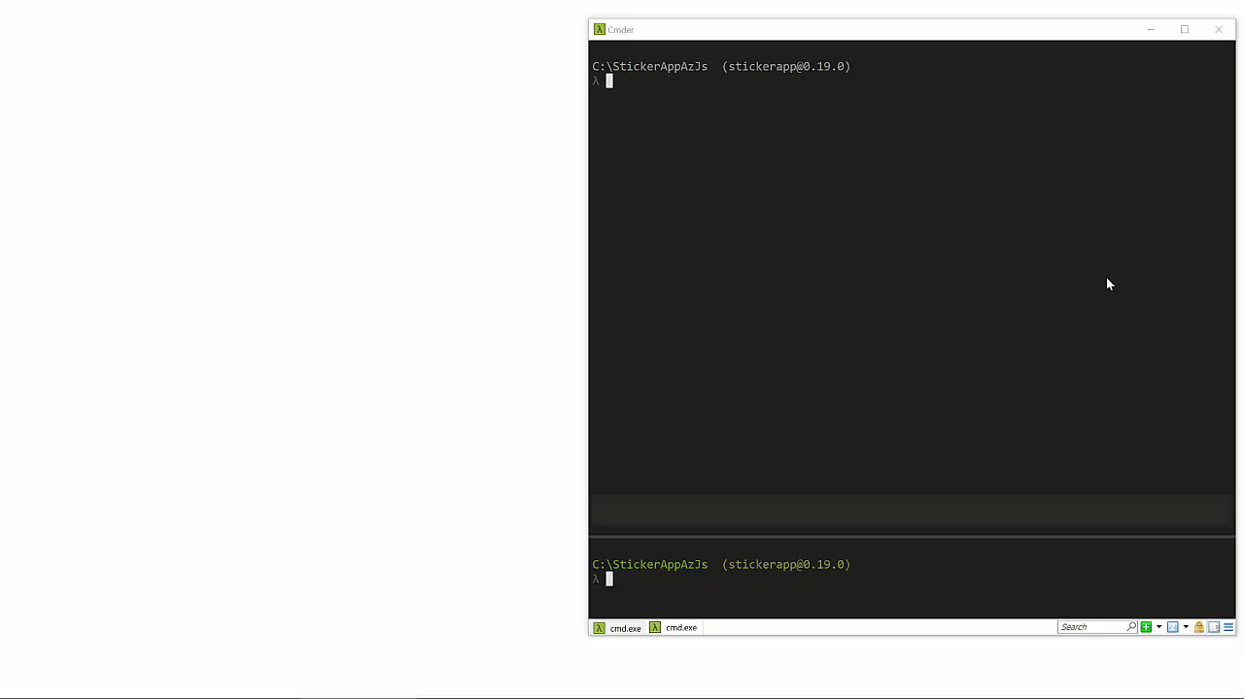
Notes:
Walk through demo.
The other vein I think about reliability in is measured in Change Failure Rate. This is how oftern you and your team make a deployment that requires a rollback, hotfix or other remediation. We want to avoid deployments as much as possible, so we’re experimenting with an autologger and log visualizer of sorts called project Glimpse.

Slide 15
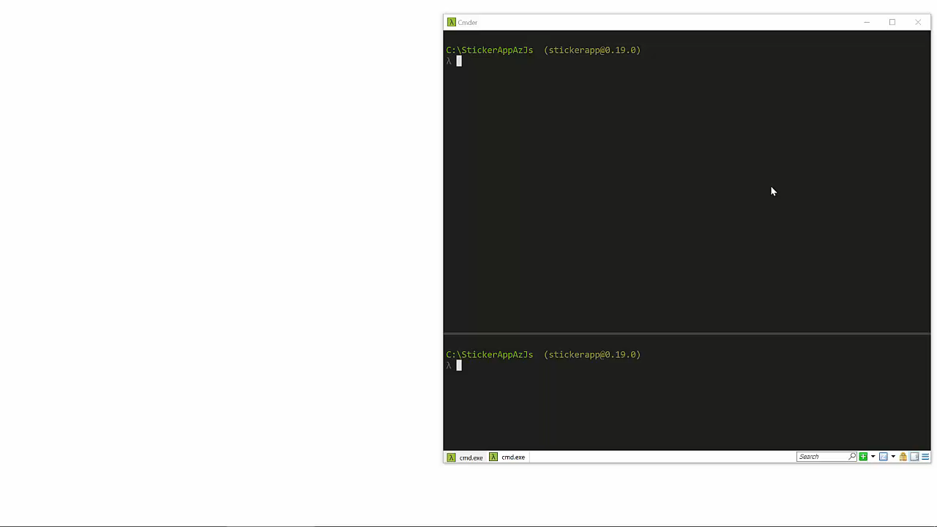
Notes:
Glimpse demo:
Logs
Web Services
Request
Timeline

Slide 16

Useable.

Slide 17
OpenFin
Secure
Interoperable
Deployment
Ecosystem
DX -> UX
Notes:
Secure is really part of reliable. If an app isn’t secure, it can’t be used reliably.
OpenFin builds on top of the Chromium Sandbox, extends the Group Policy options and all code loaded from the file system is check summed, signed and validated.
The ecosystem is what allows things like TypeScript, logpoints and Glimpse to just work.

Slide 18
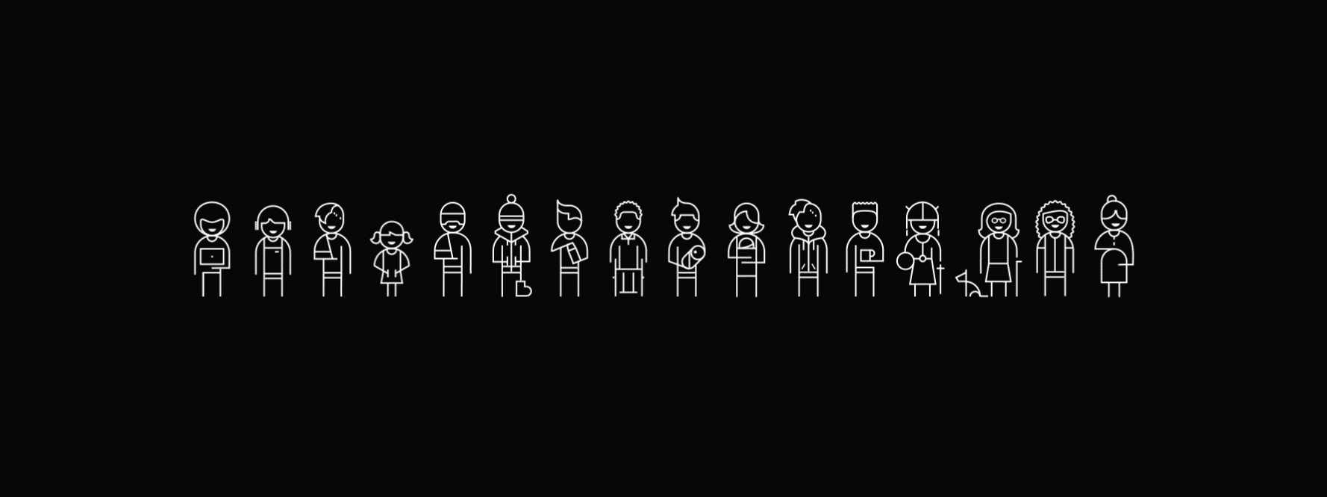

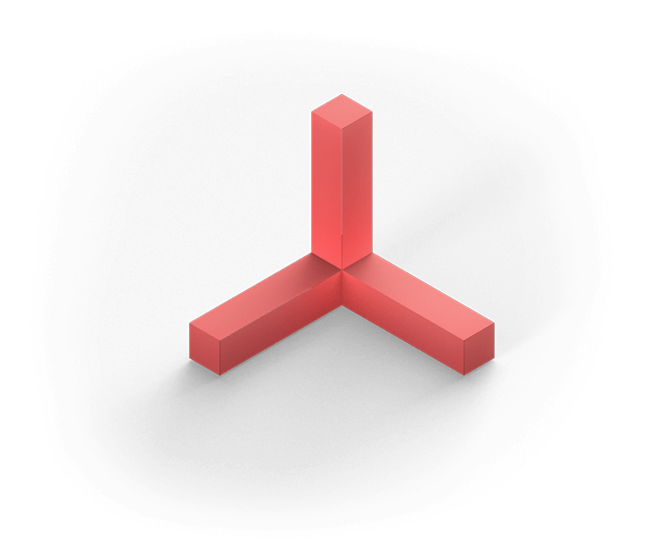
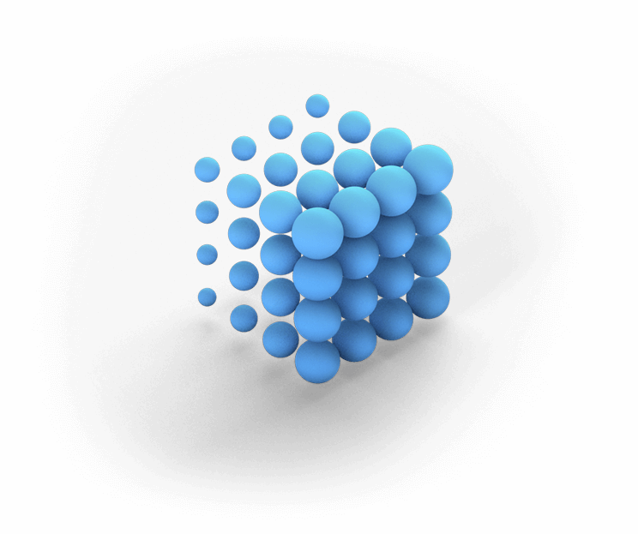
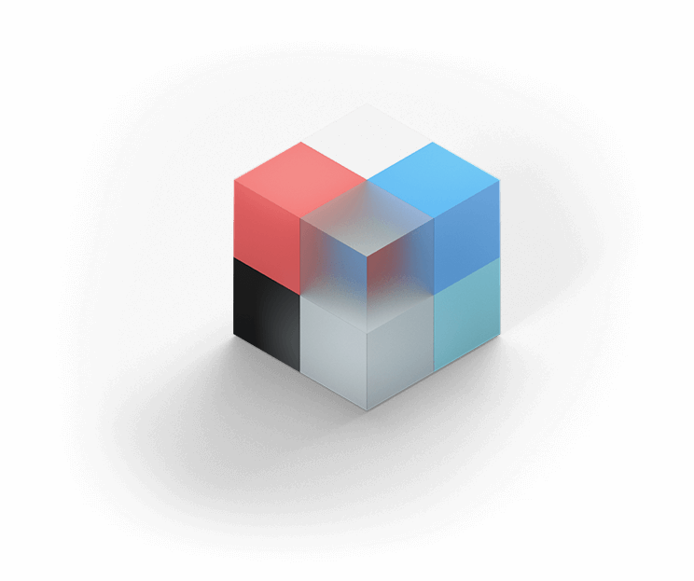

Inclusive
+
Fluent
Notes:
Fluent, from left to right: Light, Depth, Motion, Material, Scale

Slide 19

Performant.

Slide 20
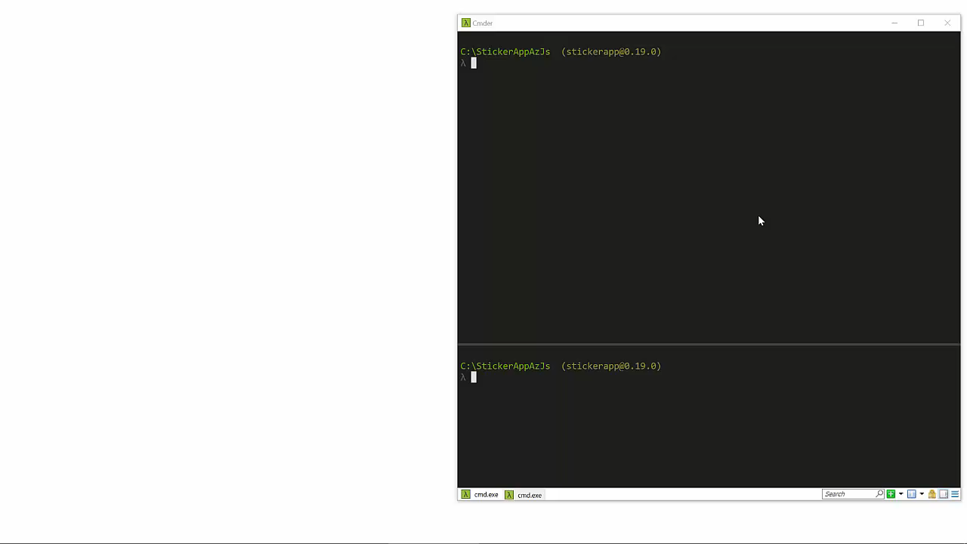

Slide 21

Pleasurable.
Notes:
So with these tools in hand, and in collaboration with Microsoft, OpenFin and the community, we should be able to treat our users as guests, and build software that’s not only functional, reliable, usable and performant – but also pleasurable and more quickly.

Slide 22

Nik Molnar  nikmd23  nikmd23
Thank You!
https://aka.ms/better-apps-faster

